Slide 1

Economic Growth and/or Economic Development Strategies
4.10
Copyright Bananaomics

Slide 2

Trade Liberalisation
Copyright Bananaomics

Slide 3
Trade Liberalisation
Trade Liberalisation - When countries remove all trade barriers such as tariffs, subsidies, quotas, or administrative barriers.
Trade is one of the most important factors in an economies ability to grow and develop.
Copyright Bananaomics

Slide 4

Trade Liberalisation
Strenghts
  Economic integration in developing countries leads to greater access to a variety of goods at theoretically lower prices and greater quality.
  Increases in exports
  Access to larger markets
  Improved international cooperation
  Efficient resource allocation
  WTO involvement and support
Copyright Bananaomics

Slide 5
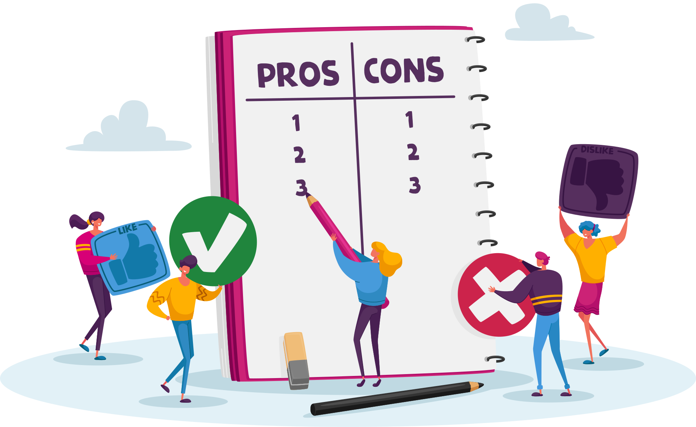
Trade Liberalisation
Limitations
  Infant industries may be phased out or unable to compete
  Potential increase in domestic unemployment
  More reliant on foreign imports
  Potential exposure to dumping
  Loss of tariff revenue for the government
  More difficult to protect population safety
Copyright Bananaomics

Slide 6

Diversification
Copyright Bananaomics

Slide 7

Diversification
Most developing countries lack the variety of production and exports.
Diversification allows developing countries to be protected from economic shocks to specific sectors, reduce exchange rate fluctuations, and promote the growth of sectors outside of the primary sector.
Copyright Bananaomics

Slide 8

Social Enterprise
Copyright Bananaomics

Slide 9

Social Enterprise
A company whose main objective is to have a social impact rather than to make a profit for their owners or shareholders. It operates by providing goods and services for the market in an entrepreneurial and innovative fashion and uses its profits primarily to achieve social objectives.
Social enterprises earn profit but typically put the profits back into their social objective. They are typically classified as for-profit or not-for-profit organizations.
Social enterprises strive to provide essential goods, services, or resources in areas where local businesses or government intervention has failed.
Copyright Bananaomics

Slide 10

Social Enterprise Example
The LifeStraw explained: How it filters water and eradicates disease
CNET
Copyright Bananaomics

Slide 11

Market-Based Policies
Copyright Bananaomics

Slide 12

Market-Based Policies
There are several policies designed to encourage competition and efficiency.
  Trade liberalization (already discussed)
  Privatization
  Deregulation
Privatization - When government-owned industries are sold to the private owners
  Improves efficiency and promotes competition
  Decrease in government spending and increase in revenue
  Equity issues - preferential selling of cheap government-owned industries lead to wealth inequity
Deregulation - Removing rules and restrictions enforced by the government.
  Removes barriers for start-up business
  Lower costs of production
  Public health and security concerns arise
Copyright Bananaomics

Slide 13

Interventionist Policies
Copyright Bananaomics

Slide 14

Redistribution
Redistribution policies are designed to redistribute wealth and income equally in society. These policies are generally effective in countries where income equality is low and social mobility is diifficult.
Common redistribution policies include:
  Progressive Tax Reform
    Poor countries have a largely informal, untaxed economy with no formal income, so they typically use regressive indirect taxes on goods and services. Progressive taxation allows most of the tax burden to fall on those with high income, allowing for more disposable income in the lower class.
  Transfer Payments
    Countries with established tax revenue can implement transfer payments that give funds directly to lower-income families to provide greater income, opportunity, and well-being.
  Minimum Wage
    Minimum wage requirements can help protect vulnerable workers from exploitation and increase income equality in society.
Copyright Bananaomics

Slide 15

Provision of Merit Goods
Copyright Bananaomics

Slide 16

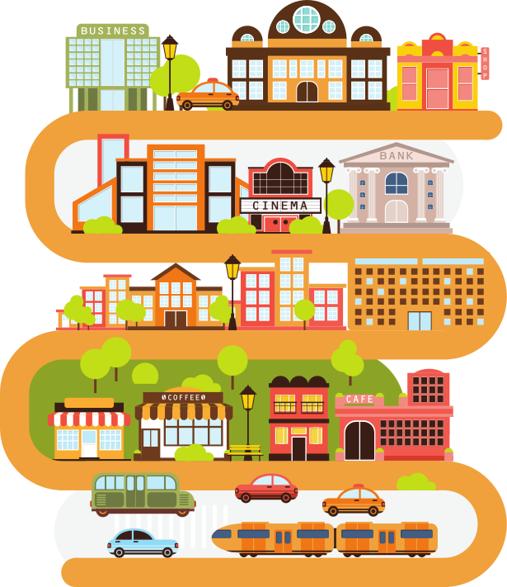

Provision of Merit Goods
Economic Growth and Development can be improved through government provision of merit goods such as education, healthcare, and infrastructure.
Copyright Bananaomics

Slide 17

Foreign Direct Investment
Copyright Bananaomics

Slide 18

Foreign Direct Investment (FDI)
FDI occurs when large multinational corporations (MNC) invest in a country.
Inwards FDI positive effects:
  increases jobs
  increases growth and development
  improves infrastructure
  improves human capital (knowledge transfer)
  increases government business tax revenue
Inward FDI negative effects:
  Loss of control of capital
  Over-reliance on foreign firms
  Environmental Damage
  High barriers for infant industry competitiors
Copyright Bananaomics

Slide 19

Foreign Aid
Copyright Bananaomics

Slide 20

Foreign Aid
Humanitarian Aid
Aid for countries where people are struggling to fulfill basic needs. Typically this type of aid focuses on food, medical, or natural disasters.
Developmental Aid
Aid is provided to achieve long-term development.
Types of Developmental Aid
  Grants, loans, project/program aid.
  NGO (Non-Governmental Organization) Aid
  Official Developmental Assistance (ODA)
  Debt Relief
Copyright Bananaomics

Slide 21
How Foreign Aid Can Hurt Development.
Friendly Fire: How Foreign Aid Hurts Development | Abhishek Parajuli | TEDxOxford
Copyright Bananaomics

Slide 22
Should Voluntourism Exist?
Samantha Nutt on the Problems of Volunteer Tourism | NowThis
Copyright Bananaomics

Slide 23

Multilateral Development Assistance
Copyright Bananaomics

Slide 24

Multilateral Development Assistance
This term refers to receiving assistance from organizations countries contribute to. The World Bank and the International Monetary Fund (IMF) are the two most popular examples.
The World Bank
Goal: Reduce Poverty
Functions: provides low-interest loans, policy advice, technical assistance, and financial assistance with a strong focus on long-term factors of production growth.
The International Monetary Fund (IMF)
Goal: Economic Stability
Functions: provides conditional loans, economic surveillance, development policy creation
Copyright Bananaomics

Slide 25

Institutional Change
Copyright Bananaomics

Slide 26

Gender Equality
Gender inequality hinders women's access to education, political empowerment, and economic opportunity.
Some general recommendations to combat these issues are:
  Addressing and eradicating gender stereotypes
  Establish laws prohibiting gender discrimination
  Ensure equal rights under the law
  Promote gender hiring initiatives or quotoas.
Copyright Bananaomics

Slide 27


Corruption
Corruption is a significant barrier to development.
Some actions to reduce corruption in general are:
  Establish an effective justice system and the rule of law
  Reform public administrational roles and auditing process to ensure transparency
  Promote freedom of the press
  Close international loopholes that may fund corrupt leaders
  Promote transparency and the power of communities
Copyright Bananaomics

Slide 28

Mini Project
Copyright Bananaomics

Slide 29

Action Plan
Click the button above and select a developing country to focus on.
Once a country is chosen:
  Research what specific significant barriers are hindering economic development. (cite sources)
  Develop a plan of action with a list of actions that could be done to counter some of these barriers to development.
  Formulate your findings in a document and be ready to share and present. It should look realistic and professional.
Copyright Bananaomics

Slide 30

Enjoying The Content?
Visit bananaomics.com to purchase package deals with discount prices!
BANANAOMICS

